Slide 1
Today’s Agenda
Boolean Algebra

Slide 2
Boolean Algebra
Variable
Complement
Literal
Notes:
Variable: A variable is a symbol usually an uppercase letter used to represent a logical quantity.
A variable can have a 0 or 1 value.
Complement: A complement is the inverse of a variable and is indicated by a bar over the variable.
Complement of variable X is X*
If X = 0 then X*= 1 and if X = 1 then X*= 0
Literal: A Literal is a variable or the complement of a variable. X and X* are literals

Slide 3
Boolean Addition & Multiplication
Boolean Addition performed by OR gate
Sum Term describes Boolean Addition
Boolean Multiplication performed by AND gate
Product Term describes Boolean Multiplication

Slide 4
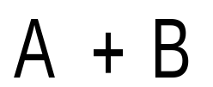
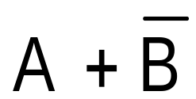
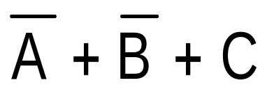
Boolean Addition
Sum of literals
Sum term = 1 if any literal = 1
Sum term = 0 if all literals = 0
Notes:
Sum term is described as sum of literals

Slide 5
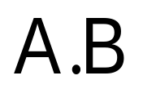
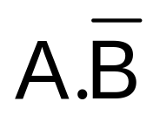
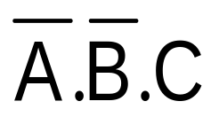
Boolean Multiplication
Product of literals
Product term = 1 if all literals = 1
Product term = 0 if any one literal = 0
Notes:
Product term is described as product of literals

Slide 6
Laws, Rules & Theorems of Boolean Algebra
Commutative Law
  for addition and multiplication
Associative Law
  for addition and multiplication
Distributive Law
Rules of Boolean Algebra
Demorgan’s Theorems

Slide 7
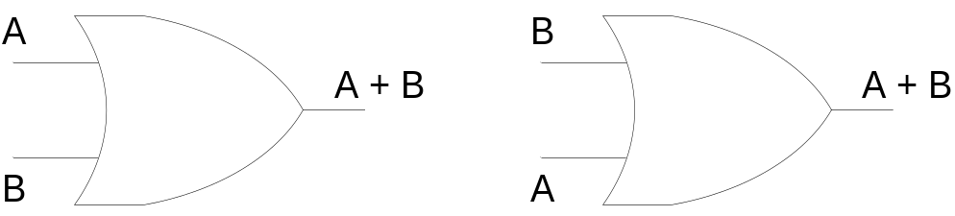
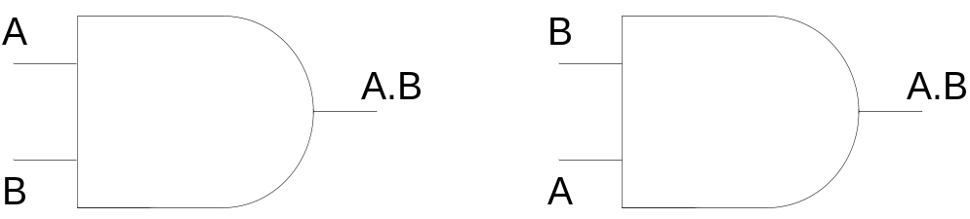
Commutative Law
Commutative Law for Addition
A + B = B + A
Commutative Law for Multiplication
A.B = B.A
Notes:
The basic laws of Boolean Algebra are the same as ordinary algebra and hold true for any number of variables

Slide 8
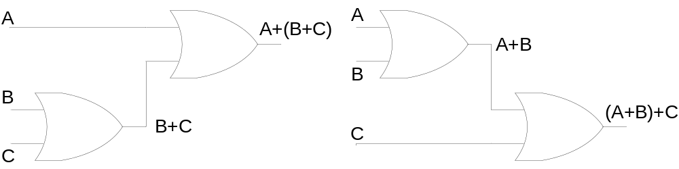
Associative Law
Associative Law for Addition
A + (B + C) = (A + B) + C
Notes:
The sum term B OR C Ored with A is the same as sum term A OR B Ored with C

Slide 9
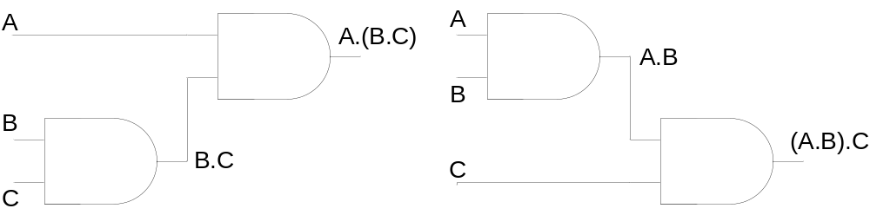
Associative Law
Associative Law for Multiplication
A.(B.C) = (A.B).C
Notes:
The product term BC Anded with A is the same as AB Anded with C

Slide 10
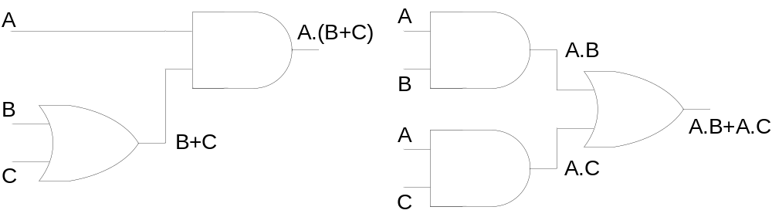
Distributive Law
A.(B + C) = A.B + A.C

Slide 11


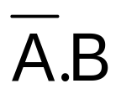

Rules of Boolean Algebra
A + 0 = A
A + 1 = 1
A.0 = 0
A.1 = A
A + A = A
A + = 1
A.A = A
A. = 0
= A
A + A.B = A
A + = A + B
(A+B).(A+C)
= A+B.C
Notes:
A+A*B = A(B+1)+A*B using rule 2
=AB+A+A*B
=A+AB+A*B =A+B(A+A’) = A+B
= A+B
(A+B)(A+C) = A+AC+AB+BC
= A(1+C+B)+BC
=A+BC

Slide 12
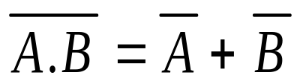
Demorgan’s Theorems
First Theorem
Demorgan’s First Theorem states: The complement of a product of variables is equal to the sum of the complements of the variables.

Slide 13
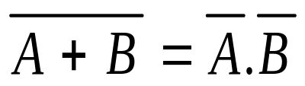
Demorgan’s Theorems
Second Theorem
Demorgan;s Second Theorem states: The complement of sum of variables is equal to the product of the complements of the variables

Slide 14
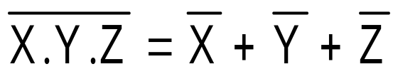
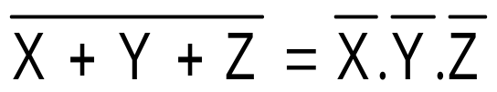
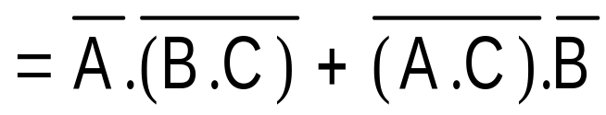
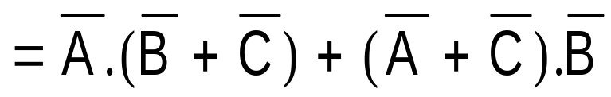
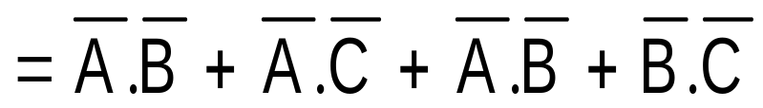
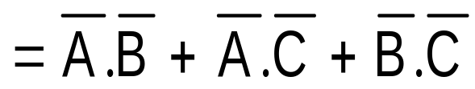
Demorgan’s Theorems
Any number of variables
Combination of variables
Notes:
Demorgan’s Theorems can be applied to expressions having any number of variables
Demorgan’s Theorem can be applied to a combination of other variables

Slide 15
Boolean Function:
Boolean function is composed of binary variables and logical operation symbols.
For given values of variables value of function is either ‘1’ or ‘0’ for example:
F₁= x + y’z
F₁=1 when either x =1 or y’z =1 otherwise ‘0’.
y’z=1 when y=0 and z=1

Slide 16
Boolean Function:
Any Boolean function can also be represented in a truth table. If Boolean function has ‘n’ different variables then truth table will have 2^{n} rows.
x
0
0
0
0
1
1
1
1
y
0
0
1
1
0
0
1
1
z
0
1
0
1
0
1
0
1
F₁
0
1
0
0
1
1
1
1

Slide 17
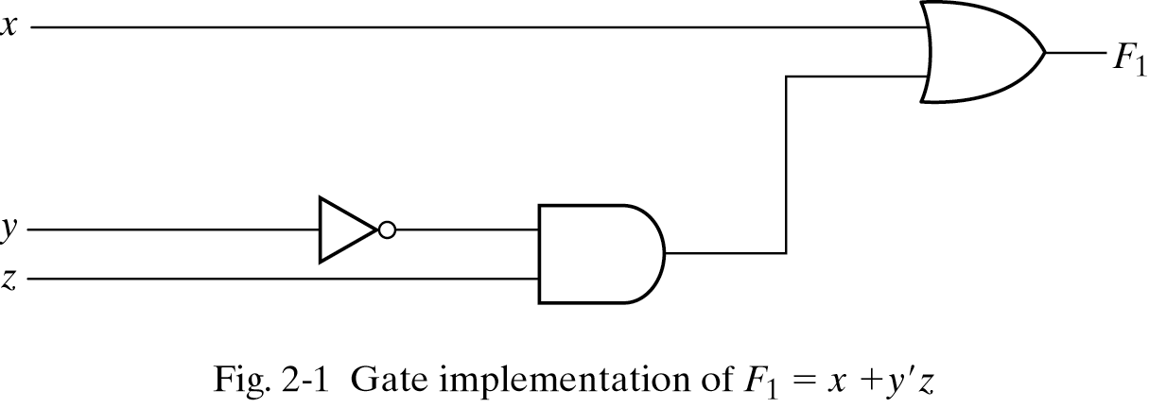
Boolean Function

Slide 18
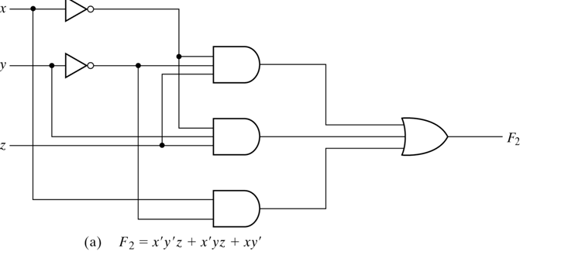
Reducing Boolean Expressions/Functions
F₂=x’y’z + x’yz + xy’
x
0
0
0
0
1
1
1
1
y
0
0
1
1
0
0
1
1
z
0
1
0
1
0
1
0
1
F₂
0
1
0
1
1
1
0
0

Slide 19
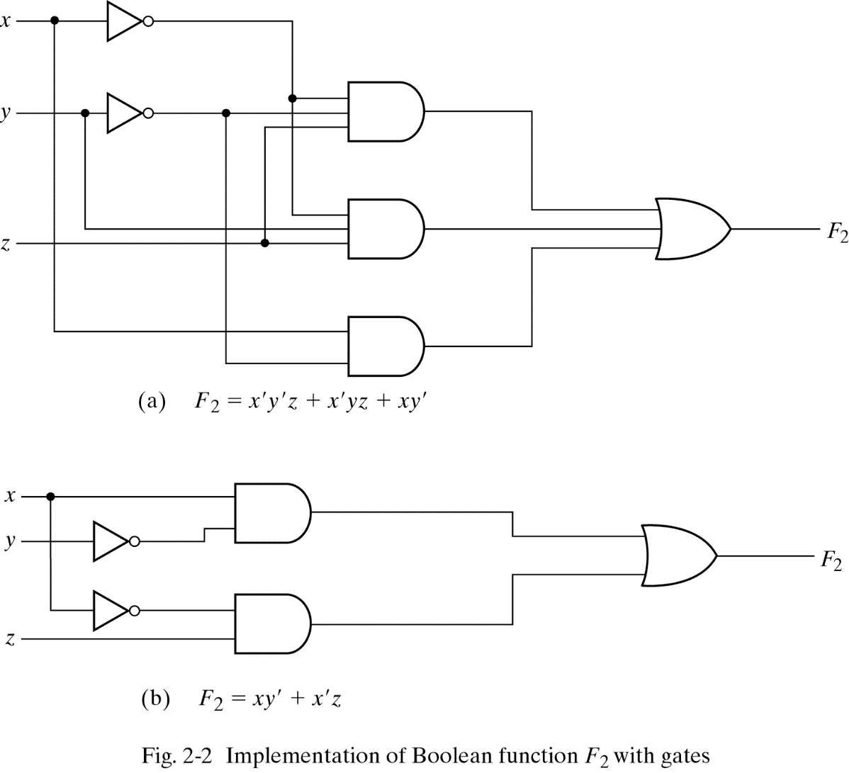
Reducing Boolean Expressions/Functions

Slide 20
Examples:
Simplify the following expressions to a minimum number of literals:

Slide 21
Home Work
2.3, 2.4, 2.5

